Slide 1
Capstone project - Sport Analytics
BY:
MOHAMED ASRAR ALI S

Slide 2
MECE breakdown for sports analysis
Athelete Analysis
Sports Analysis
Games Analysis
Sports Trend
Gender Analysis
Regional Analysis
Age Distribution
Events Analysis
Regional Dominance
Participant pattern
Medal Analysis
Event Level Trend
Medal Trends
Level Analysis
Participants in different sports, games, evolved overtime
Evaluating different medals across regions and their excellence overtime
Host city impact
Comparison b/w participants who won medals across different regions and gender
Medal distribution
Analysis on popularity over time and over decades.
Comparison b/w Male and female
Analysis on which sport got which medal
Decadal Trend
Evaluate game trends over decades
Compare age distribution of athletes across different games
Analyse the no of participants across regions
Examine the geographic spread of host cites and their benefits
Evaluate the number of events held for men, women
Evaluate who won in more than one event
Evaluate highest number of medals
Analysis on age, gender, country, awards etc….
Performance Evaluation
Participants Analysis
Demographic Insights

Slide 3

ER Diagram

Slide 4
Tools used:
Power bi: Used to establish relationship between the tables and performs measures and gives details understanding of the problems through visualization.
sql: It is a query language that used to understand the data to perform data processing
excel: It is a visualization tools which helps us to understand the problem easily.

Slide 5
Power BI
Problem Statements

Slide 6
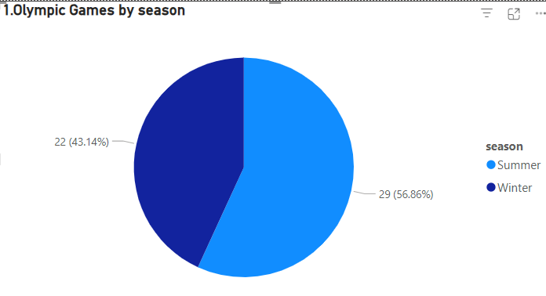
1.How many Olympic Games have been held in each season (Summer vs. Winter)?
Conclusion:
In each Olympic games , in summer there are 29 games and in winter there are 22 games.

Slide 7
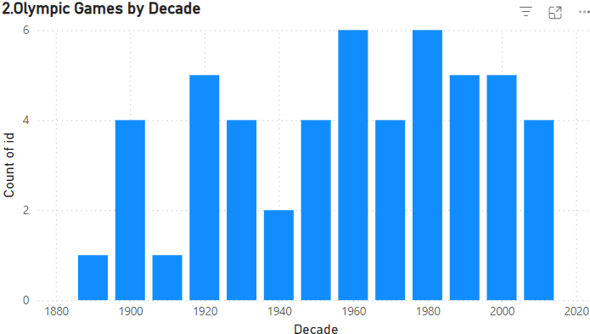
2.What is the distribution of games across different decades?
Conclusion:
The Olympic games are at its peak in the year 1960 and 1980 and little slow in its earlier years like 1880 and 1900.

Slide 8
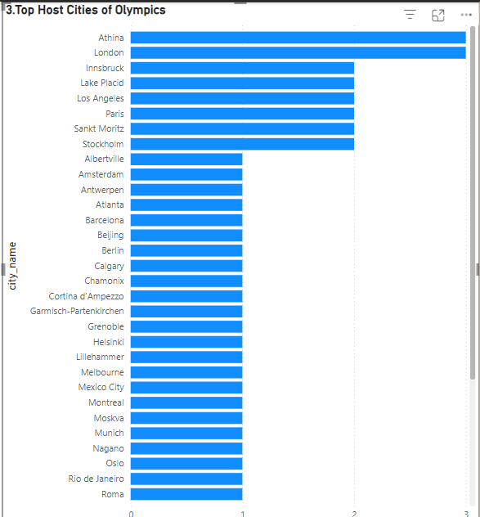
.
3.Which cities have hosted the most Olympic Games?
Conclusion
London (3 times),Athina(3 times), Paris (2 times), Los Angeles (2 times).
Cities in developed nations dominate hosting frequency

Slide 9
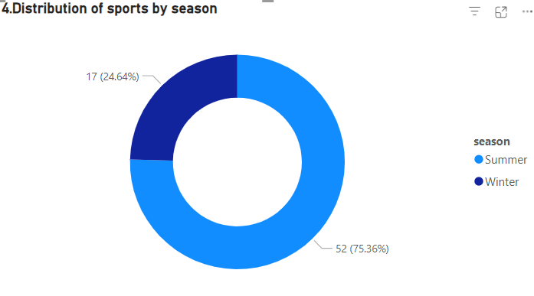
4.What is the distribution of sports between Summer and Winter Olympics?
Conclusion
IN Olympics games summer season has more distribution of games then winter that is in summer there are 52 sports and in winter there are 17 sports

Slide 10
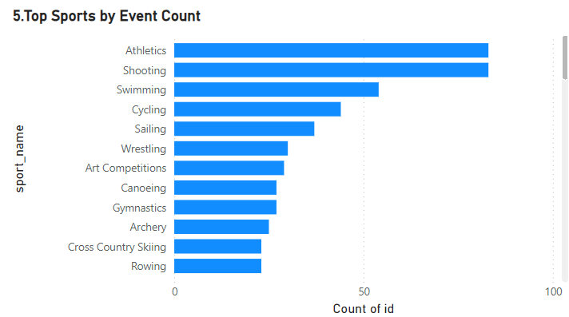
5.Which sports have the highest number of events in the Olympics?
Conclusion
Sports like Athletics and shooting,swimming held more number of event in Olympic games.

Slide 11
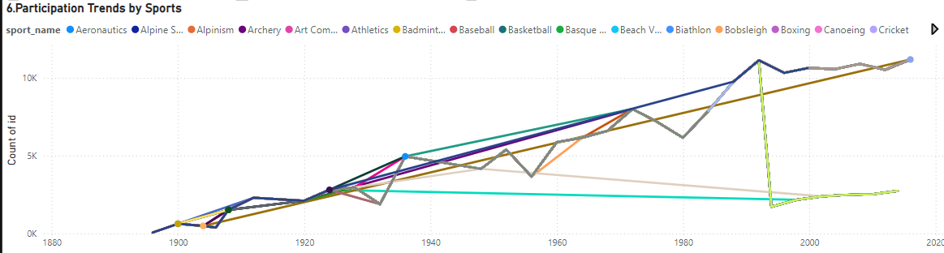
6.How has the participation in each sport evolved over time?
Conclusion:
Consistent growth in traditional sports; new sports like Golf and Tennis.
The participants trends of sports increased over year to year.

Slide 12
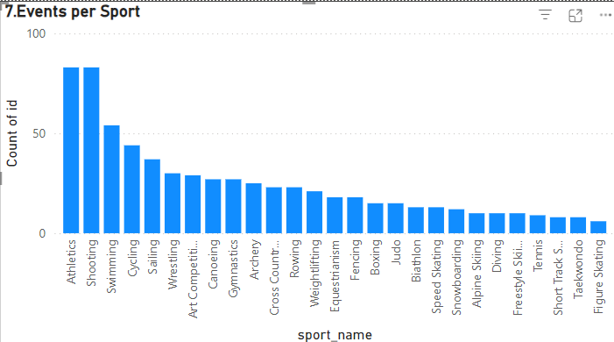
7.How many events are there in each sport?
Conclusion:
sports like atheletics,shootingand swimming has more number of event in Olympic games then others
sports like taekwondo,alpine skiing has less number of event in Olympic games.

Slide 13
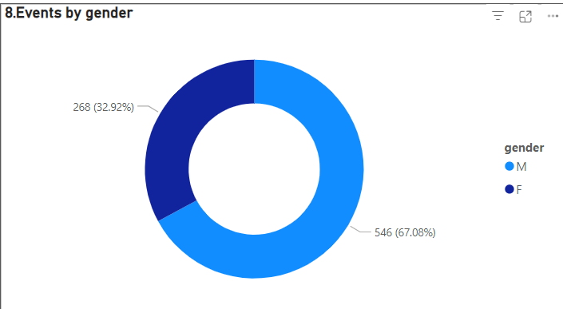
8.What is the distribution of events by gender (Men, Women, Mixed)?
Conclusion:
Mens have participated in more events than womens in Olympic games. Mens participated in 546 events while womens participated in 268 events

Slide 14
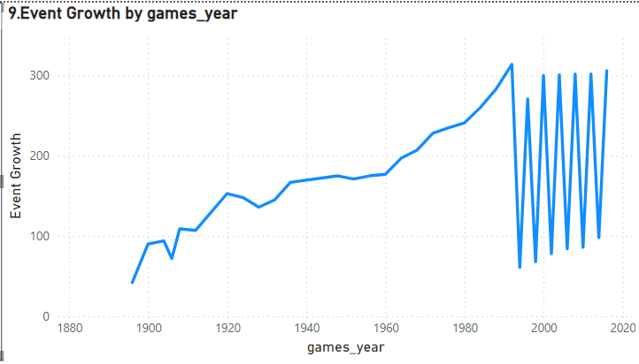
9.How has the number of events changed over time?
Conclusion
In Olympic games number of events are increases over years rapidlty.
And after 1980 the number of events are not constant it varies up and down.

Slide 15
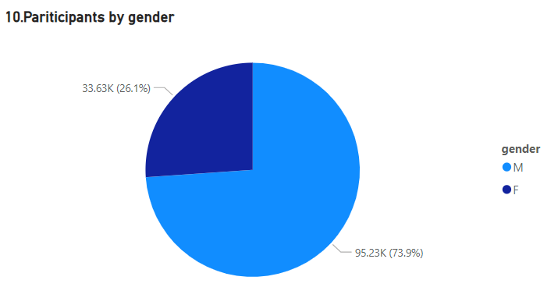
10.What is the distribution of participants by gender?
Conclusion:
The participants in Olympic games are mostly males compare to females.
The total number of participants of males are 95.23k and females are 33.63k.

Slide 16
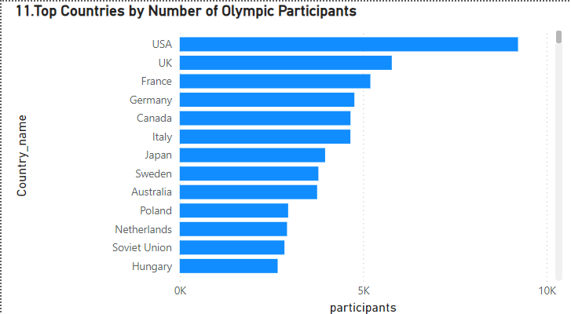
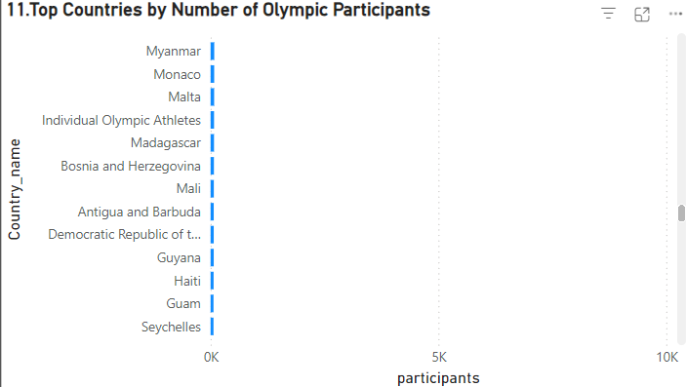
11.Which countries have the highest number of participants in the Olympics?
Conclusion:
Countries like USA,UK,France etc has highest number of participants in Olympic games.
Countries like Haiti,guam,Guyana hs least numbers of participants ion Olympic games.

Slide 17
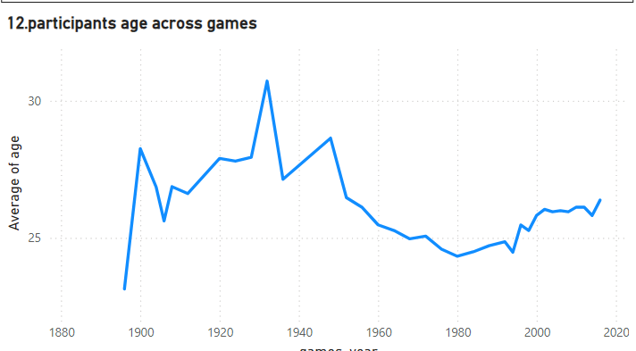
12.How does the age distribution of participants vary across different games?
Conclusion:
Participants age varies across years in Olympic games.
In 1920 to1940 there is highest age participants while after 2000 the age is between 24 to 27.

Slide 18
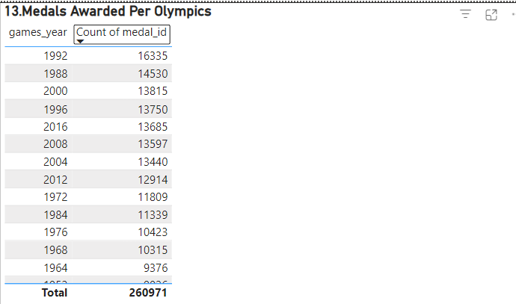
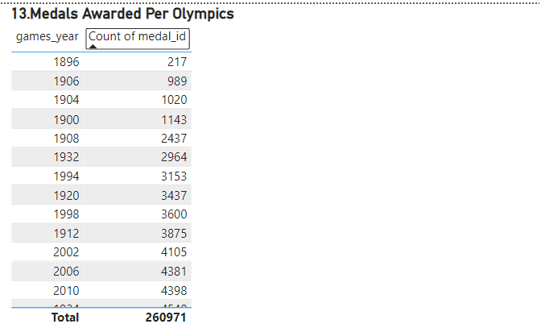
13.How many medals have been awarded in each Olympics?
Conclusion:
In 1992,1988,2000 there are large number of awards are awarded in Olympic games.
In 1896,1906,2002 there are less number of awards are awarded in Olympics games.

Slide 19
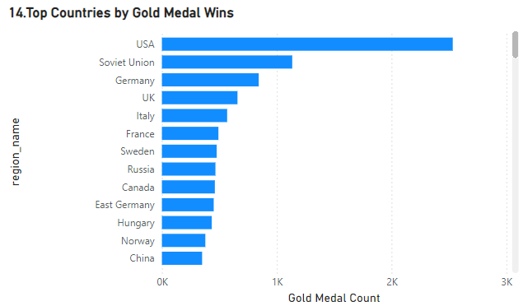
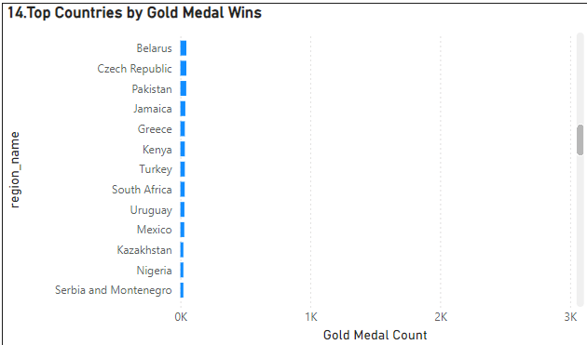
14.Which countries have the highest number of gold medals?
Conclusion:
Countries like USA,Soviet Union ,Germany has received more number of Gold medal.
Countries like Turkey,South Africa,Mexico has received less number of gold medal.

Slide 20
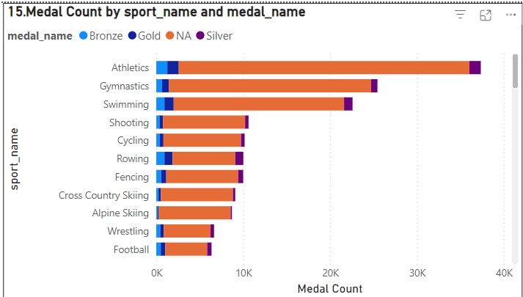
15.How does the medal distribution vary across different sports?
Conclusion:
Sports like Athletics , Gymnastics has more medals than other games.

Slide 21
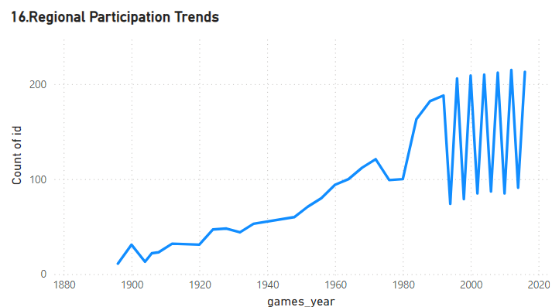
16.How many regions or NOCs participate in each Olympic Games?
Conclusion:
Region wise participants are increased through the year and it is not stable after 1990.

Slide 22
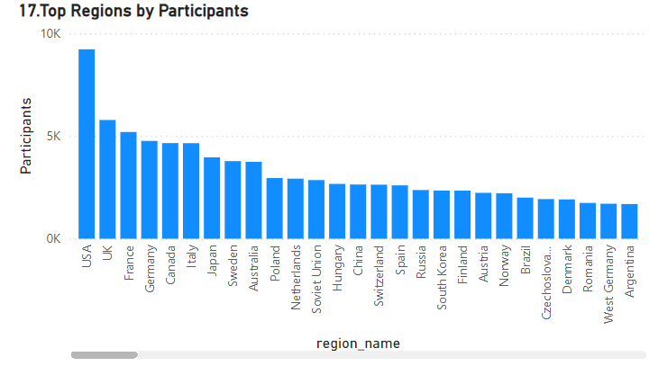
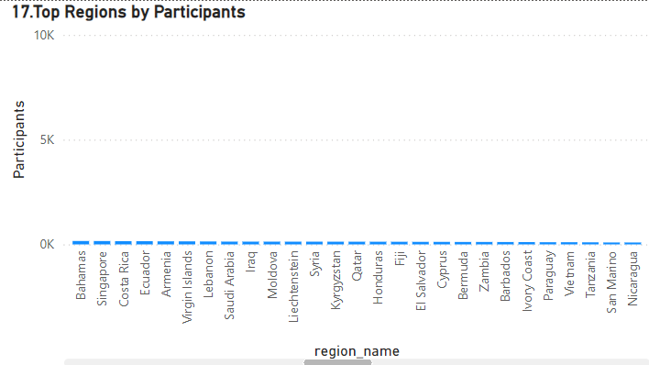
17.Which regions have the highest number of participants in the Olympics?
Conclusion:
Countries like USA , UK has highest regions by participants.
Countries like Fiji, cyprus , Zambia has least regions by participants.

Slide 23
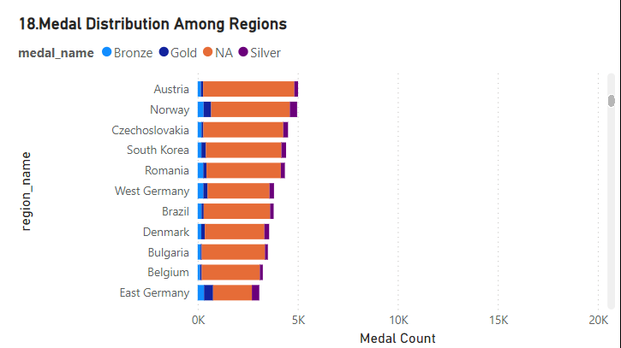
18.What is the distribution of medals among different regions?
Conclusion:
Countries like Austria , Norway ,Romania has high medal distribution across the region.

Slide 24
EDA Analysis

Slide 25
Are there any trends or patterns in the frequency of hosting Olympic Games?
Conclusion:
Some cities, like London, Athina , Los Angeles, and Paris, have hosted multiple times, indicating their prominence in global sports infrastructure and historical significance.
Hosting was more frequent in Europe during the early 20th century, with a gradual shift to other continents in the 21st century.
Countries in Europe and North America dominate hosting frequency.

Slide 26
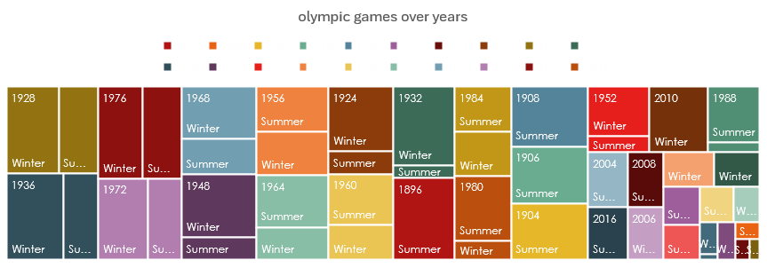
2.How has the duration of Olympic Games changed over time?
Conclusion:
Most recent games typically last 15-17 days, allowing for a two-week format aligned with global broadcasting schedules.
The 1908 London Olympics lasted 187 days due to event spread.
The 2020 Tokyo Games faced delays and challenges from the COVID-19 pandemic, but the duration of events remained similar.
Winter Games also follow a similar pattern, typically lasting 14-16 days.

Slide 27
3.Are there any notable events or occurrences associated with specific Olympic Games?
Conclusion:
Number of participants varies across all the Olypimcs due to various reasons.
The Olympic Games have witnessed numerous notable events and occurrences that have shaped history. These include record-breaking performances, moments of political significance, groundbreaking inclusions (e.g., gender equality milestones), and technological innovations. Each edition of the Games reflects a unique intersection of sports, culture, and societal change, leaving a lasting legacy on the global stage.

Slide 28
4.Are there any emerging sports that have been recently added to the Olympics?
Conclusion:
Games like Gymnastics,Badminton etc are recently added games.
These additions reflect the evolving interests of younger audiences and global sports culture, ensuring the Olympics stay relevant and inclusive in the modern era.

Slide 29
5.How has the popularity of certain sports changed over the years?
Conclusion:
Number of participants increased in games like Gymnastics,Athletics,Swimming over years.
Traditional sports like athletics and swimming remain popular, while newer sports such as e-sports and extreme sports are gaining traction, reflecting shifting audience preferences globally.

Slide 30
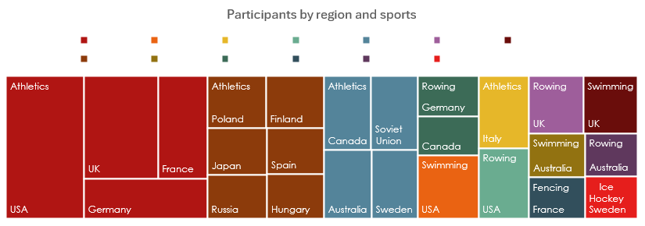
6.Are there any sports that are specific to a particular region or culture?
Conclusion:
Sports like Athletics shows more dominance in USA and UK orRowing in Germany

Slide 31
7.Are there any sports that have a higher number of events for one gender compared to others?
Conclusion:
Sports like art competitions ,archery etc has high number of event count in Olympic games.

Slide 32
8.Are there any new events that have been introduced in recent editions of the Olympics?
Conclusion:
Events like speed skationg Men's 500meters speed skating,Lightweight Judo,Men's singleBadminton etc are recently added events In Olympics. These additions aim to enhance diversity, gender balance, and audience engagement, keeping the Games dynamic and modern

Slide 33
9.Are there any events that have been discontinued or removed from the Olympics?
Conclusion:
Several events, such as tug-of-war, cricket, and polo, have been discontinued from the Olympics due to declining popularity, logistical challenges, or lack of global participation. These decisions reflect the evolving focus of the Games on widely recognized and practiced sports.

Slide 34
10.Are there any notable trends in the height and weight of participants over time?
Conclusion:
Line chart shows the variation of height and weight of players over years.
For instance, athletes in sports like basketball and volleyball tend to be taller, while weightlifting shows trends toward higher body weight.
These variations reflect the physical demands and specialization required for different sports.

Slide 35
11. Are there any dominant countries or regions in specific sports or events?
Conclusion:
Countries like USA,UK,France has most dominent in Athelics,Gymnasics,Swimming in Olympics.
USA excels in swimming and athletics, China leads in table tennis and gymnastics, and European nations dominate soccer and cycling.
These trends reflect historical, cultural, and resource investments in these sports by respective countries

Slide 36
12.What factors contribute to the success or performance of participants from different countries?

Slide 37
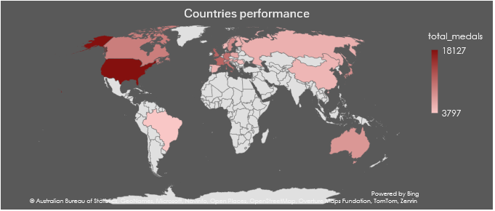
13.Are there any countries that consistently perform well in multiple Olympic editions?
Conclusion:
Countries like USA,UK,France consistently performed well in Olympics.
Their success stems from strong sports infrastructure, investment in athlete development, and diverse participation across various events.

Slide 38
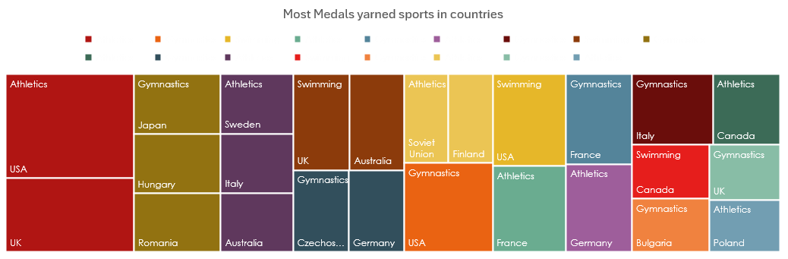
14.Are there any sports or events that have a higher number of medalists from a specific region?
Conclusion:
Athletics in USA and UK earned most medels in Olympics.
EDA shows that certain sports have a higher number of medalists from specific regions.

Slide 39
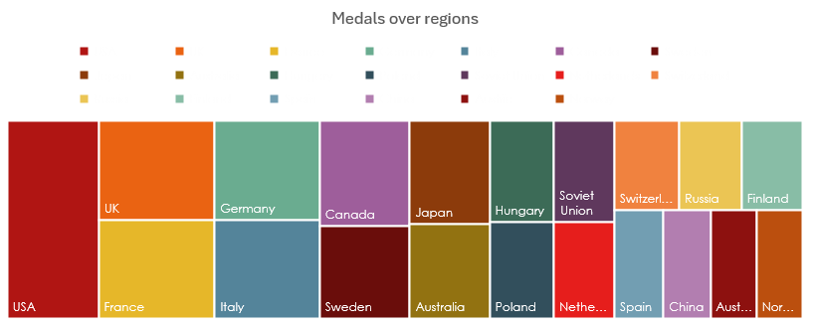
18.Are there any regions that have had a notable impact on the overall medal tally?
Conclusion:
Countries like USA,UK ,France has high on impact on overall medals tally.
Highlight regions that dominate specific sports or decades
Analyze trends over time to see whether any regions are emerging or declining in influence.

Slide 40
Thank you

